Slide 2

Placement Trend Analysis
SM VITA Institute
Academic Years: 2021-2023
2

Slide 3
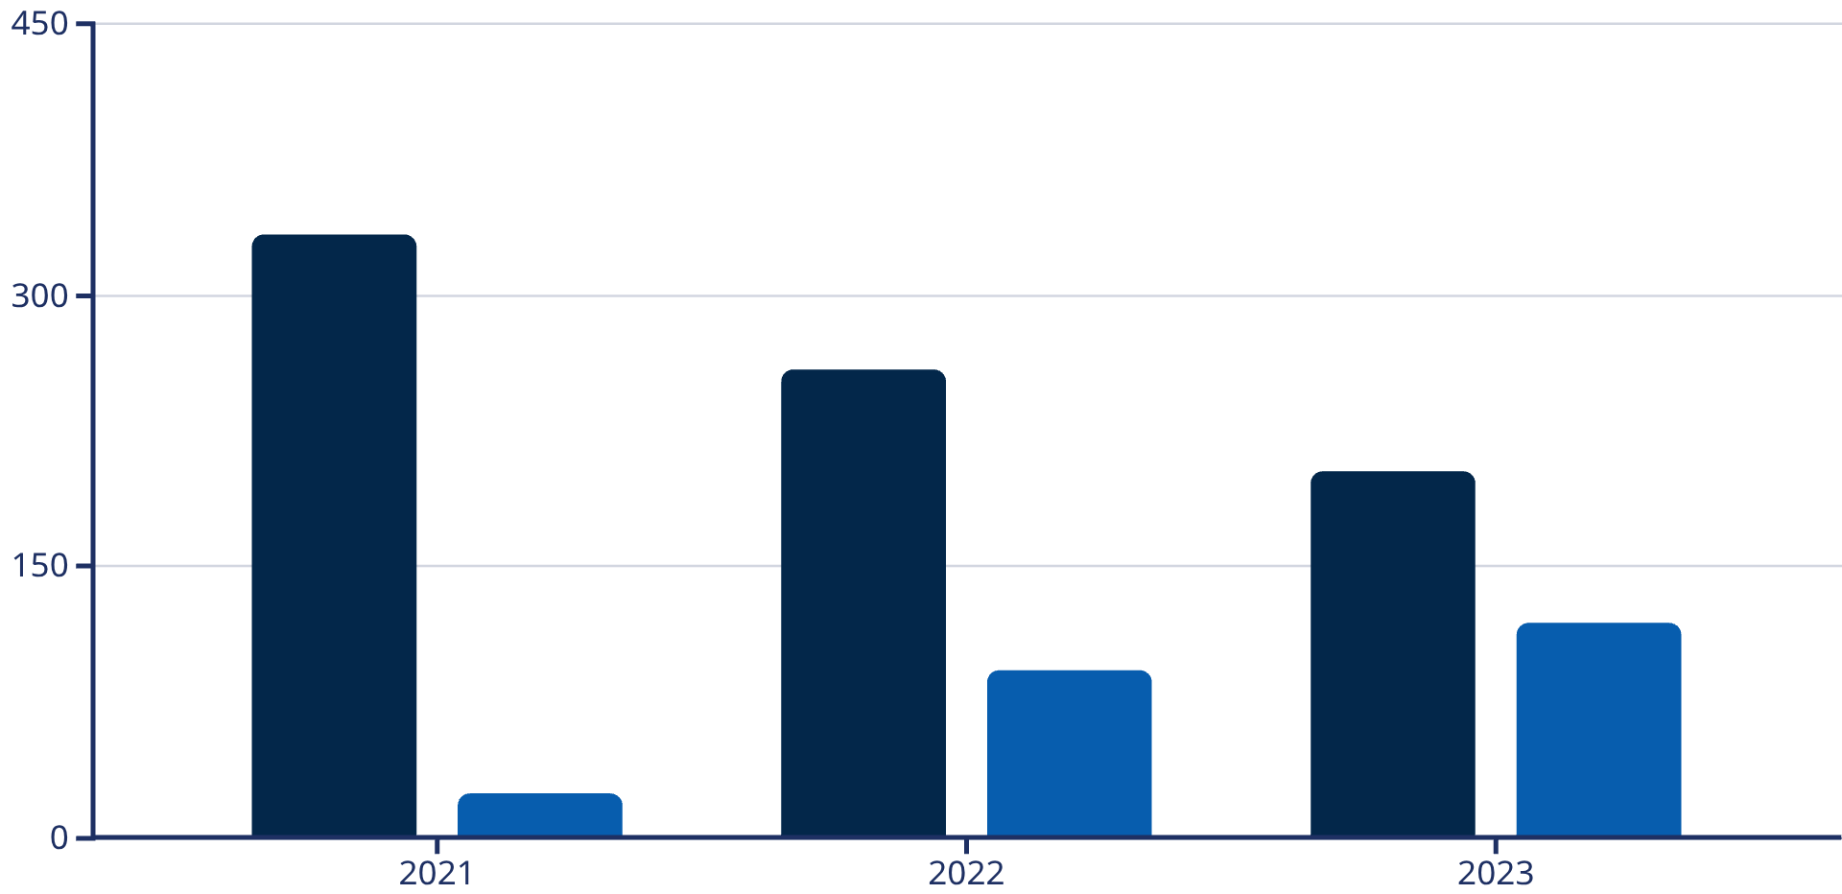
Institute Placement Overview
Total Students Appeared vs Placed (2021-2023)
2021 Placement
333 placed out of 357 total
(93.3%)
2022 Placement
259 placed out of 352 total
(73.6%)
Placed
Unplaced
2023 Placement
202 placed out of 321 total
(62.9%)
4

Slide 4
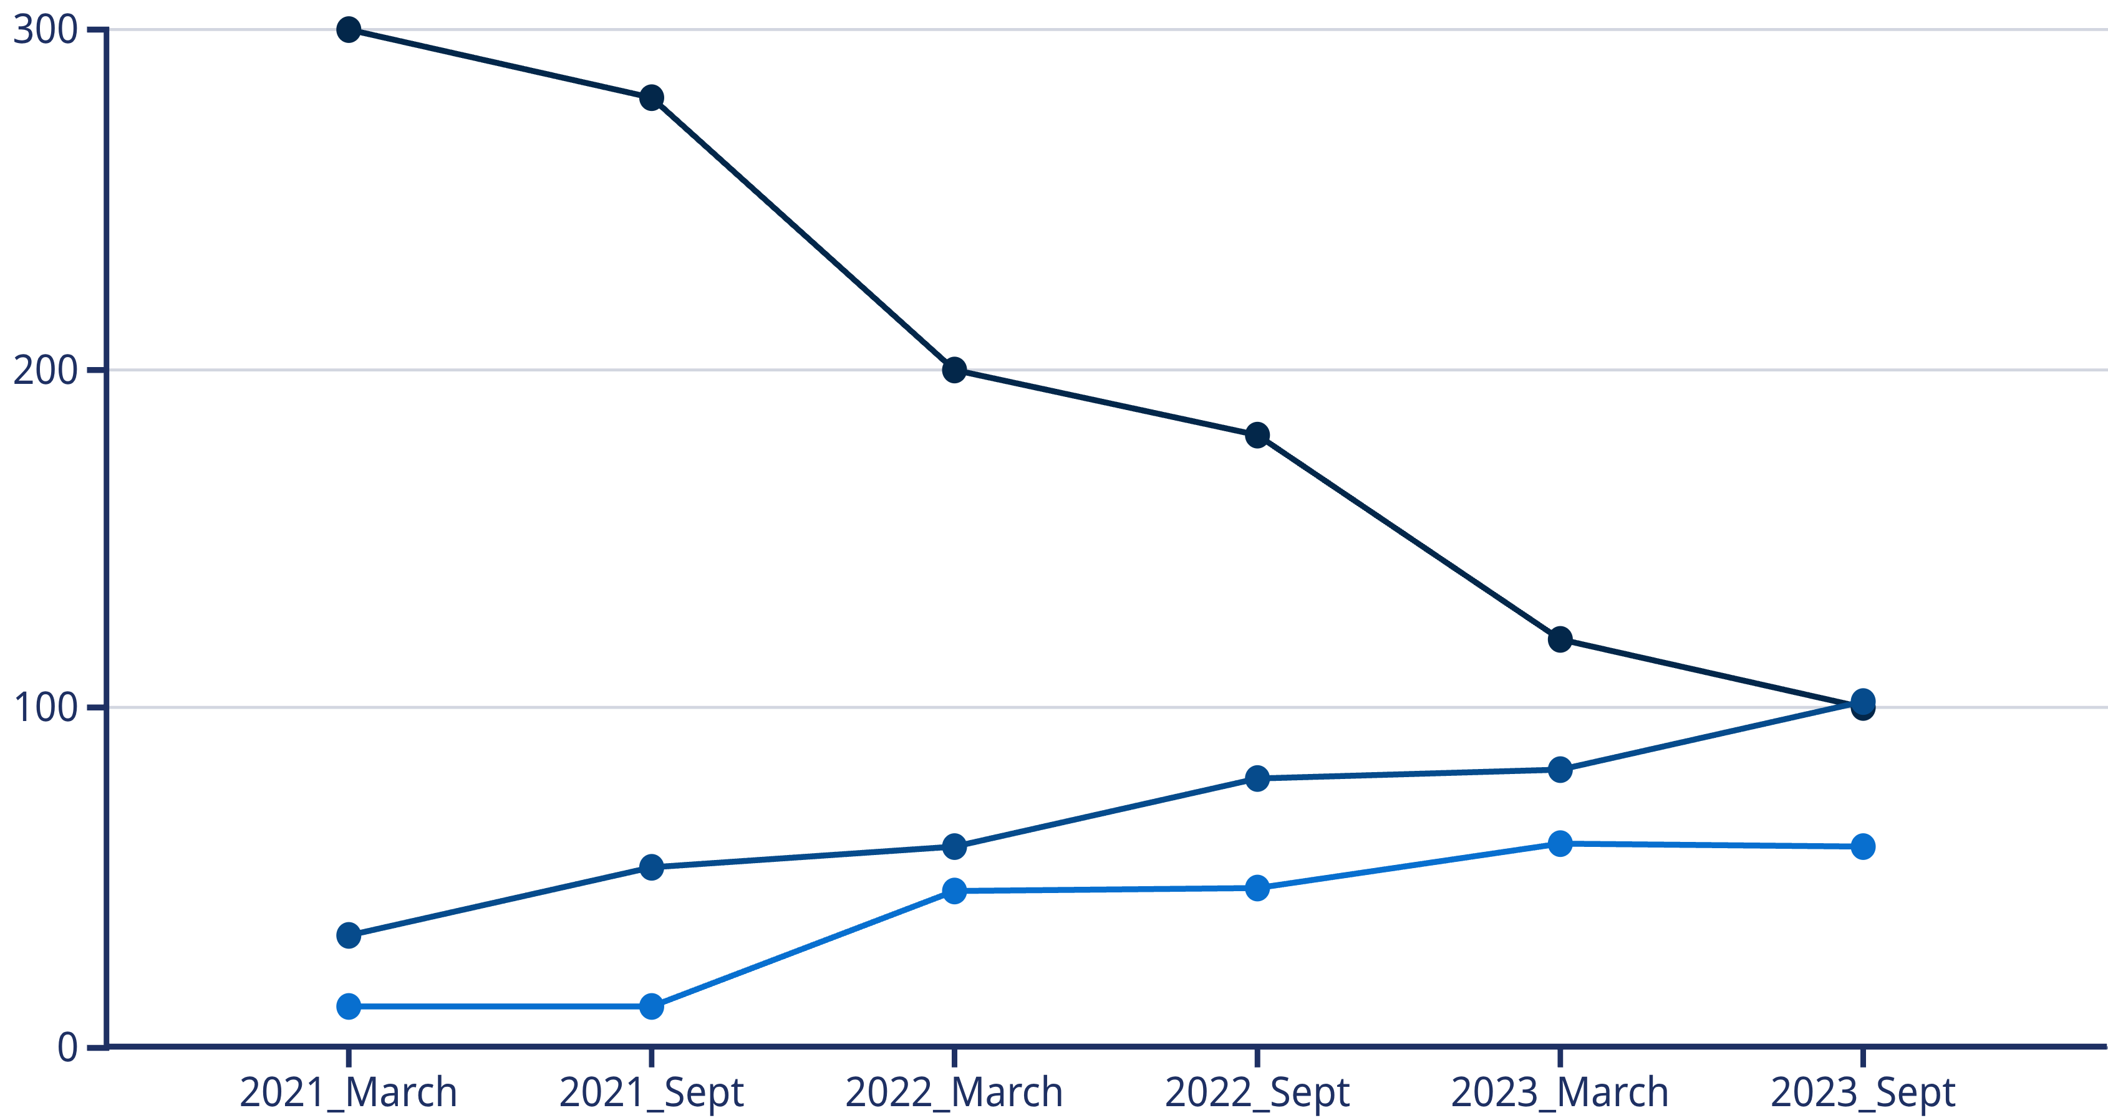
Year-wise Placement Trends
Placement Percentage Trend Analysis (2021-2023)
VITA Placed
Self Placed
Unplaced
Key Observations:
Peak placement in 2021 (March batch: ~93%)
Declining trend observed from 2021 to 2023
2023 shows lowest placement percentage (~63%)
Self-placement increasing as VITA placements decline
Gamma Tips & Tricks
5

Slide 5
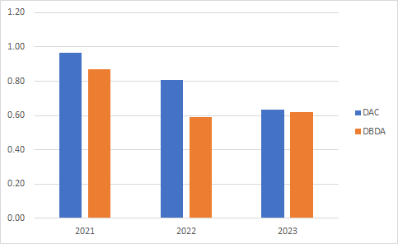
Year-wise & Batch Wise Placement Trends
Placement Percentage Trend Analysis (2021-2023)
Gamma Tips & Tricks
5

Slide 6
Course-wise Placement Analysis
DAC vs DBDA Performance Comparison
Data Analytics Course (DAC)
Database Design & Administration (DBDA)
This course consistently shows a higher placement percentage compared to DBDA.
Requires a more focused skill enhancement approach to improve placement rates.
Stronger placement outcomes observed across all years.
Comparative analysis indicates challenges in securing placements without specialized skills.
Curriculum aligns well with current industry demands for data professionals.
Opportunities exist to integrate more advanced database technologies and cloud platforms into the curriculum.
Key Insights:
DAC generally shows stronger placement outcomes due to high demand for data analytics skills.
DBDA requires a dedicated focus on skill enhancement and updating the curriculum to meet evolving market needs.
Both courses exhibit a declining trend in placement rates over the years, mirroring the overall institute trend.
6

Slide 7
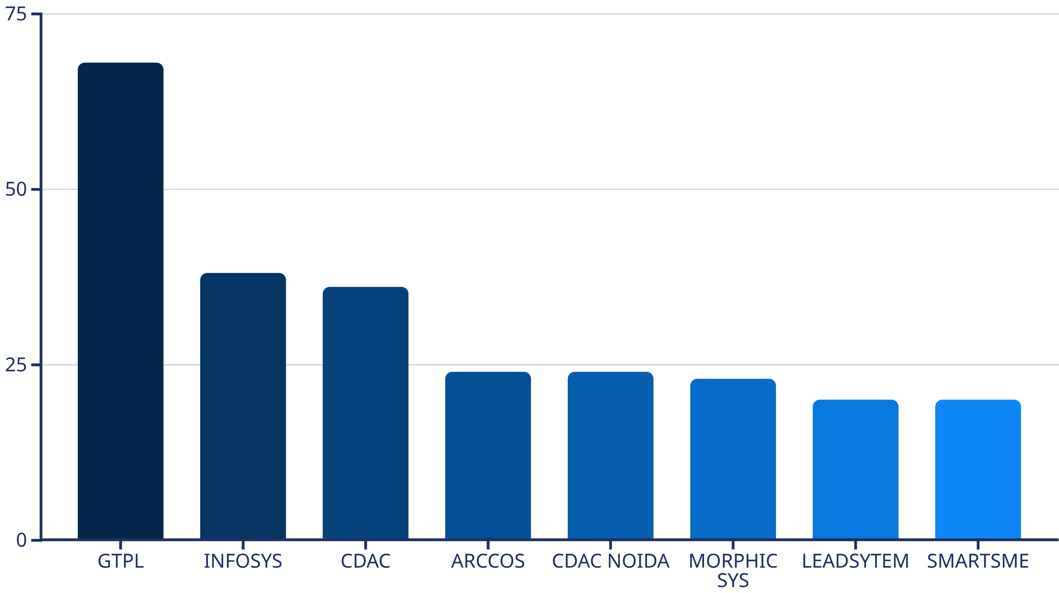
Company-wise Hiring Trends
Top Recruiting Companies & Market Concentration
Key Insights:
GTPL is the dominant recruiter (68 placements)
Top 3 companies account for significant portion of placements
Diversification needed to reduce dependency on single recruiters
Emerging companies showing interest in institute graduates
Gamma Tips & Tricks
7

Slide 8
Academic Performance vs Placement
CDAC Performance by Branch (Average Percentage)
Correlation Insights:
Electronics and Other branches show highest academic performance
Strong correlation between academic scores and placement outcomes
CDAC performance directly impacts placement success
Consistent performance across all branches (64-66% range)
Gamma Tips & Tricks
8

Slide 9



Key Insights & Observations
What Worked Well
Areas Needing Improvement
Hidden Patterns Discovered
2021 batches achieved exceptional placement rates (93.3%)
Overall placement percentage declining year-over-year
Self-placement increasing as VITA placements decline
GTPL partnership proved highly successful (68 placements)
2023 placement rate dropped to 62.9% (30% decline from 2021)
Strong correlation between academic performance and placement success
DAC course shows stronger placement outcomes
DBDA course requires curriculum enhancement
Project grades directly impact placement outcomes
Electronics and Other branches demonstrate consistent performance
Over-reliance on single recruiter (GTPL: 68 out of ~500 placements)
Age distribution shows 23-25 age group has highest placement rate
Unplaced students increasing (24 in 2021 → 119 in 2023)
Market shift towards data analytics over traditional database roles
10

Slide 10




Strategic Recommendations
Action Plan to Improve Placement Outcomes
Curriculum Enhancement
Recruiter Diversification
Update DBDA curriculum with cloud database technologies (AWS, Azure)
Expand partnerships beyond GTPL to reduce dependency
Integrate emerging technologies (AI/ML, Big Data) into DAC course
Target mid-size tech companies and startups
Strengthen project-based learning to improve project grades
Develop relationships with 10+ new recruiters annually
Industry-aligned skill development programs
Create specialized hiring tracks for different skill levels
Student Performance Focus
Market Alignment
Implement early intervention for low-performing students
Shift focus towards high-demand skills (Data Science, Cloud Computing)
Mentorship programs linking high-performers with struggling students
Conduct quarterly industry surveys to align curriculum
Regular skill assessments and remedial training
Invite industry experts for guest lectures and workshops
Career counseling starting from day one
Establish internship programs with leading companies
11

Slide 11
Conclusion
Overall Institute Performance Snapshot
SM VITA Institute has demonstrated strong placement capabilities, with 2021 achieving a 93.3% placement rate. However, the declining trend from 2021 to 2023 (93.3% → 62.9%) requires immediate strategic intervention.
Key Takeaways
Placement Performance: From peak of 333 placements (2021) to 202 placements (2023)
Market Dynamics: Shift from VITA placements to self-placements indicates changing market conditions
Academic Correlation: Strong link between academic performance and placement success
Course Performance: DAC outperforms DBDA; both require curriculum updates
Call to Action
Implement recommended strategies immediately
Focus on curriculum modernization and recruiter diversification
Monitor quarterly placement metrics and adjust strategies accordingly
Strengthen student support systems and mentorship programs
With focused efforts on curriculum enhancement, recruiter diversification, and student support, SM VITA Institute can reverse the declining trend and achieve sustainable placement growth.
12

